Slide 1
RxJS Operators
Asynchronous and event-based programs using observables

Slide 2

RxJS: Essential Concepts and Building Blocks
Subscription
Operators
Subject
Schedulers
Observable
Observer
Observable: Emits (outputs) N future values or events.
Observer: listens to values delivered by the Observable.
Subscription: represents the execution of an Observable.
Operators: pure functions that enable a functional programming style of dealing with collections with operations like map, filter, concat, reduce, etc.
Subject: is the equivalent to an EventEmitter, and the only way of multicasting a value or event to multiple Observers.
Schedulers: are centralized dispatchers to control concurrency, allowing us to coordinate when computation happens.

Slide 3
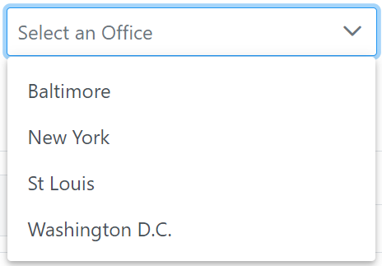
Demo 1
Field Office | Execution Time (ms)
Baltimore | 10000
New York | 5000
St. Louis | 3333
Washington DC | 2500

Slide 4
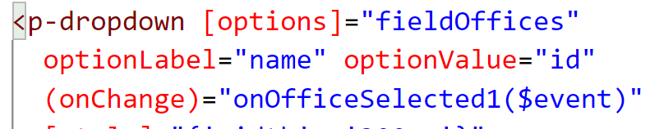
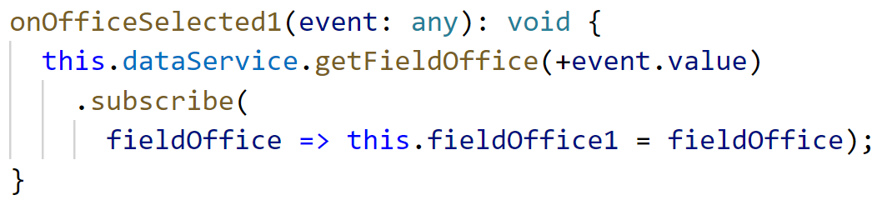
Demo 1 – Solution 1 (Avoid)

Slide 5
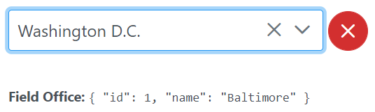
Demo 1 – Problems with Solution 1
Inconsistent application behavior
The result is not consistent with the choice in the drop-down
Memory leak
Subscription is not unsubscribed
Wash. D.C.
2500
Baltimore
10000
Time (ms)

Slide 6
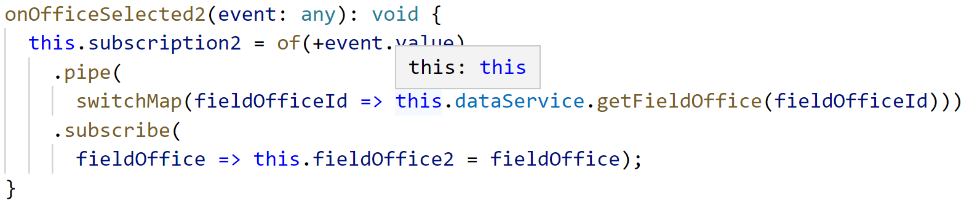
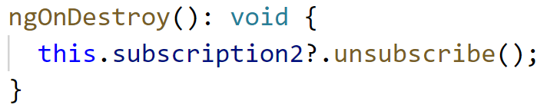
Demo 1 – Solution 2 (Better)

Slide 7
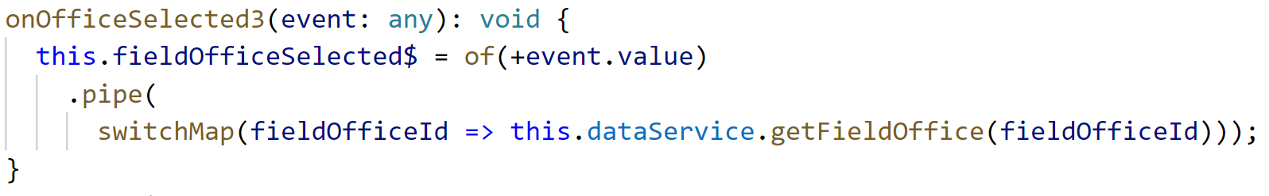
Demo 1 – Solution 3 (Best)

Slide 8
Demo 2
Get all sources for all field offices in a SPECIFIC field office order
Pseudo code
for (office in offices)
{
for (source in office.sources)
{
Print source
}
}

Slide 9

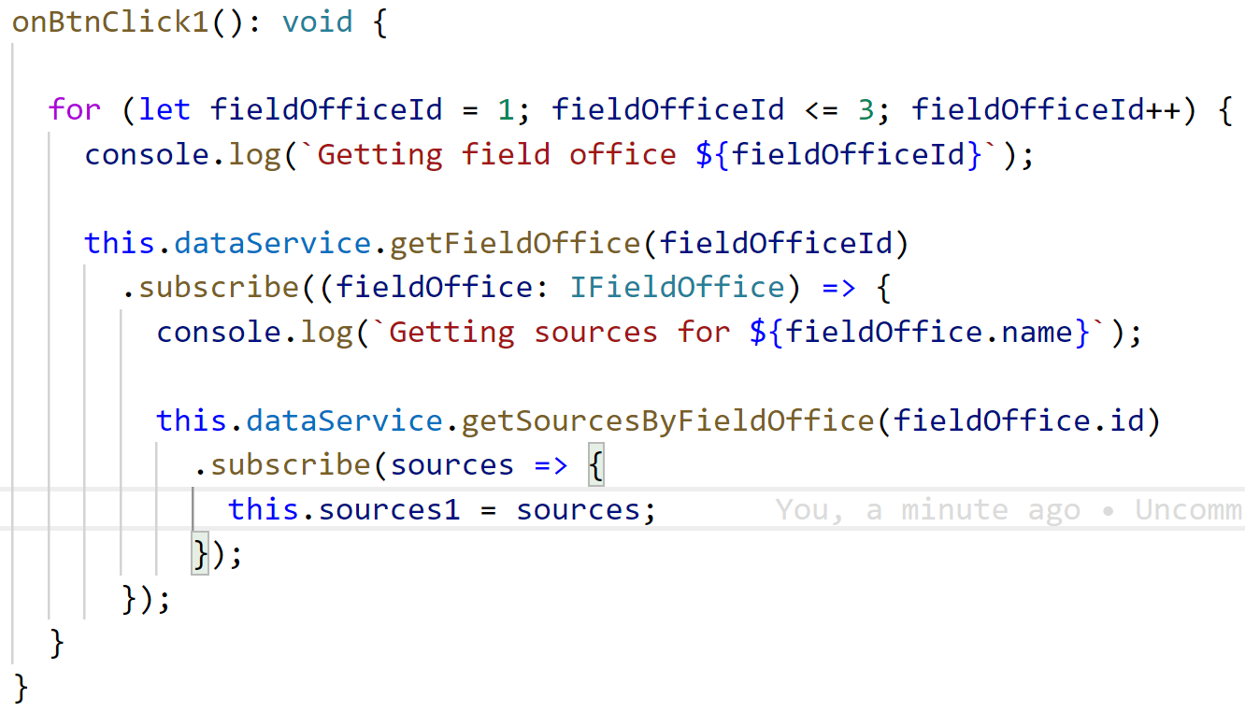
Demo 3 – Solution 1 (Avoid)

Slide 10
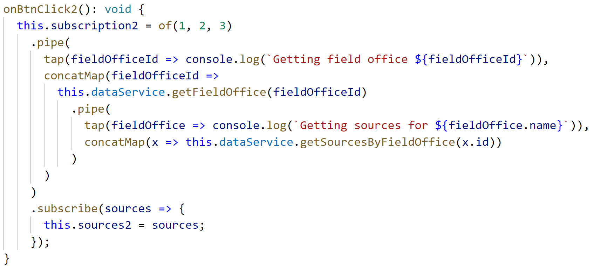
Demo 2 – Solution 2 (Better)

Slide 11
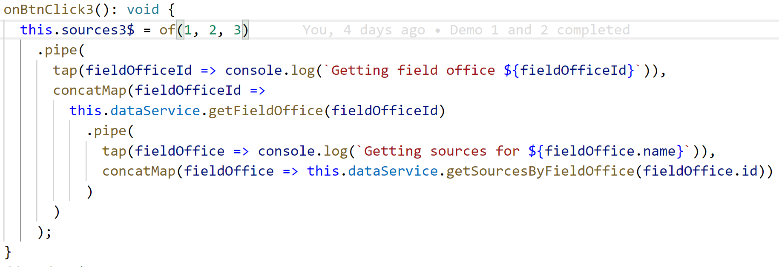
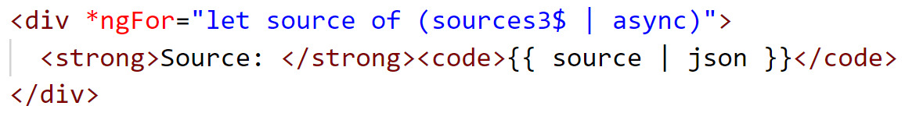
Demo 2 – Solution 3

Slide 12

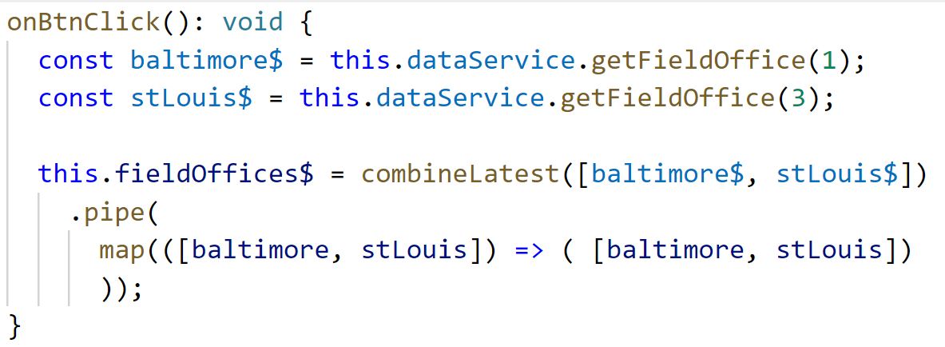
Demo 3

Slide 13


Resources
Sample Code
RxJS Overview
RxJS Decision Tree
RxJS Reference

